Slide 1



JWT Authentication & Authorisation
Mo Pazooki
@iPazooki

Slide 2
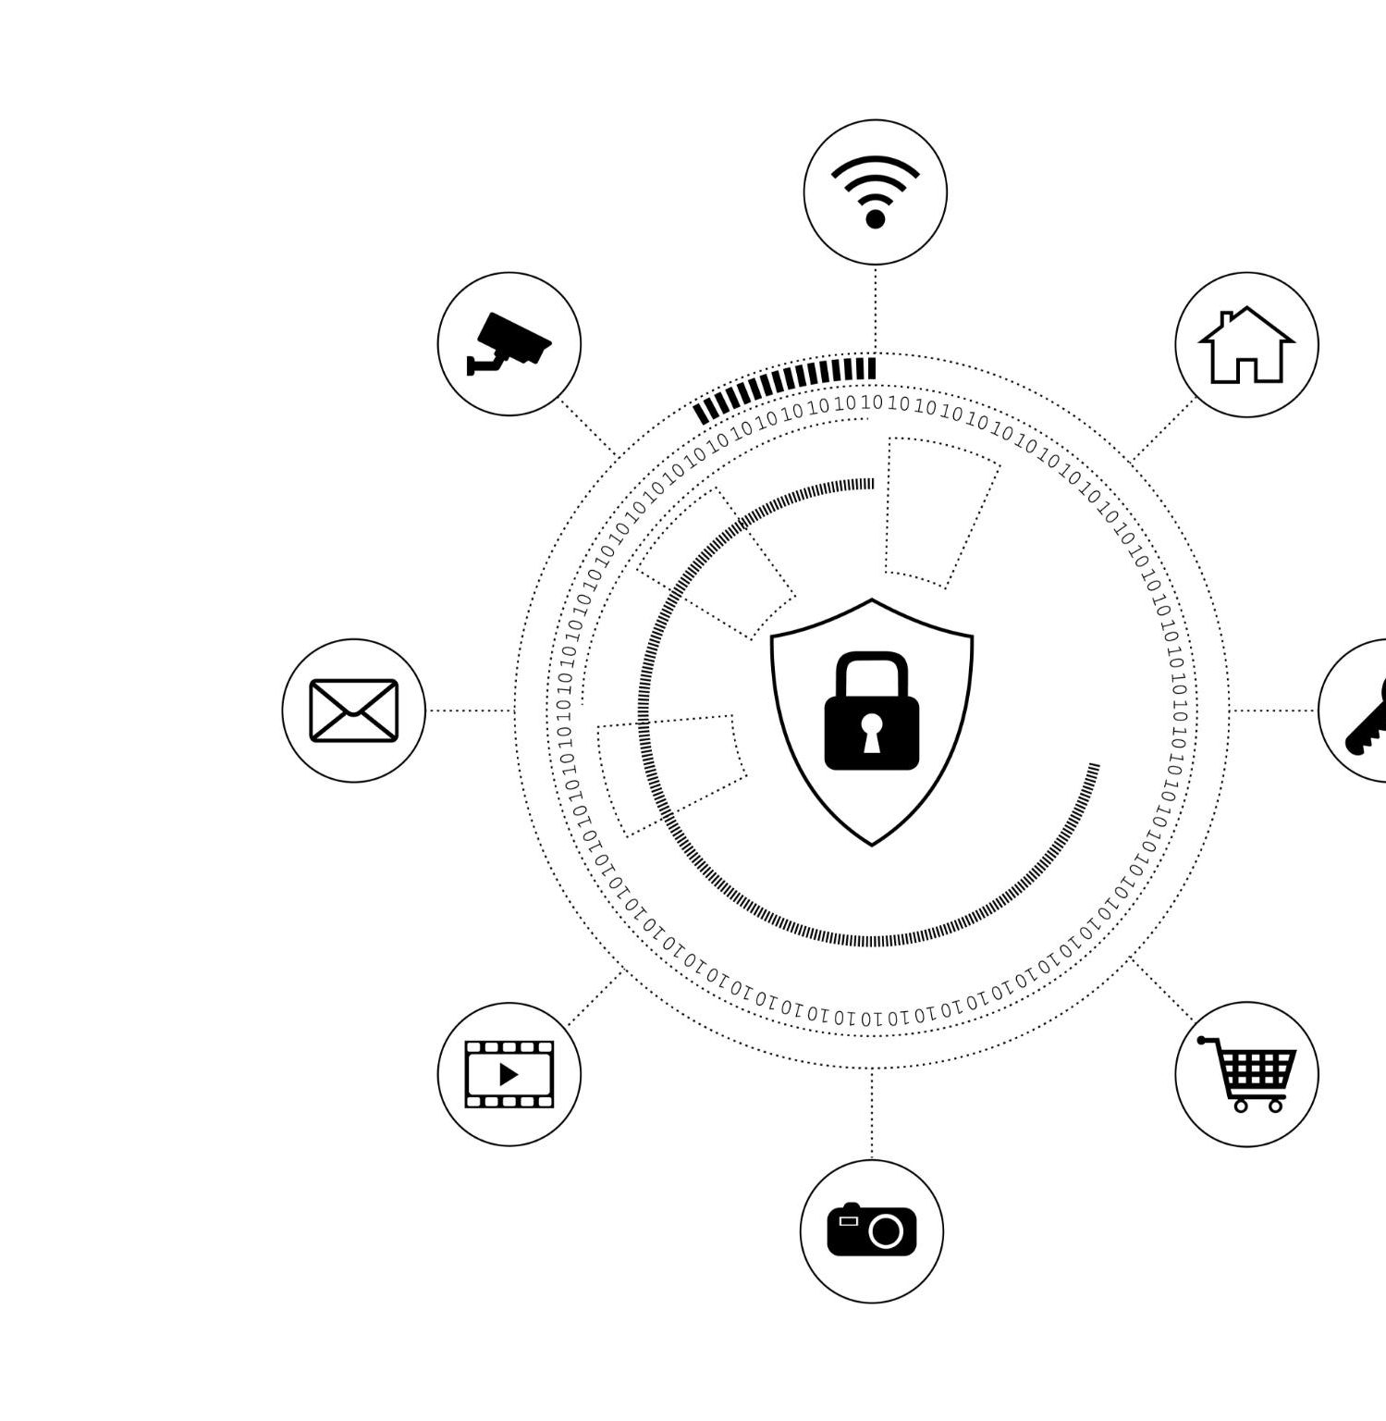
Agenda Overview
The Messy Reality? A Brief Chat About Authentication and Authorisation
Old but Gold: The Simplicity of Username & Password
Moving On Up: Introducing JWT
How JWT Works Behind the Scenes
What’s the Refresh Token All About Then?
ASP.NET Love Story: JWT in Action
Picking Your Poison: When to Choose JWT Over Others
Wrap It Up:
Notes:
We will cover a variety of topics, starting with the fundamental concepts of authentication and authorization. Then, we'll discuss traditional username and password methods before introducing JWTs and their functionality. We'll also look at refresh tokens, practical implementation in ASP.NET, and explore other authentication methods. Finally, we will analyze when to choose JWT over other options.

Slide 3

The Messy Reality? A Brief Chat About Authentication and Authorisation
Notes:
Understanding authentication and authorization is crucial in today's digital landscape. These processes ensure that users are who they say they are and that they have permission to access certain resources.

Slide 4

The Messy Reality!
Complexity and Edge Cases
Handling Various Identity Providers: Whether it's Auth0 or custom identity servers, managing different providers can get messy.
Security Risks
Session Hijacking: Attackers can hijack sessions, compromising security.
Library Updates: Keeping libraries updated to avoid vulnerabilities is crucial.
YAGNI (You Always Gonna Need It)
Initial Clean Code: It starts off clean, but as edge cases pile up, you'll find yourself needing more code than you thought.
Notes:
Authentication is the process of verifying a user's identity, while authorization determines what resources a user can access. Both are essential for securing applications and protecting user data.

Slide 5
The Vital Role of Security
The Gatekeeper of Access
Control Who Gets In and What They Can Do: Ensuring proper access control is crucial for system security.
Potential System Compromise: A single misstep in access control can lead to significant security breaches
User Experience Impact
Single Sign-On (SSO): SSO reduces friction for users, enhancing productivity and overall user experience.
Notes:
Authentication is the process of verifying a user's identity, while authorization determines what resources a user can access. Both are essential for securing applications and protecting user data.

Slide 6
Defining Authentication and Authorisation
What is Authentication?
Authentication is the process of verifying a user's identity to ensure they are who they claim to be. It is crucial for security in applications.
What is Authorization?
Authorization determines what resources a user can access after their identity is verified. This controls permissions for various user roles.
Importance of Security
Both authentication and authorization are essential for securing applications and protecting sensitive user data from unauthorized access.
Notes:
Authentication is the process of verifying a user's identity, while authorization determines what resources a user can access. Both are essential for securing applications and protecting user data.

Slide 7

Common Challenges in Authentication
Password Fatigue
Password fatigue occurs when users struggle to remember multiple passwords, leading to poor security practices.
Phishing Attacks
Phishing attacks trick users into revealing sensitive information, compromising authentication systems.
Social Engineering
Social engineering exploits human psychology to manipulate individuals into divulging confidential information.
Notes:
Challenges such as password fatigue, phishing attacks, and social engineering can undermine authentication efforts, making it vital to adopt robust methods to mitigate these risks.

Slide 8
Old but Gold: The Simplicity of Username & Password
Notes:
Despite their age, username and password combinations remain the most common method of authentication. However, their simplicity comes with notable limitations.

Slide 9
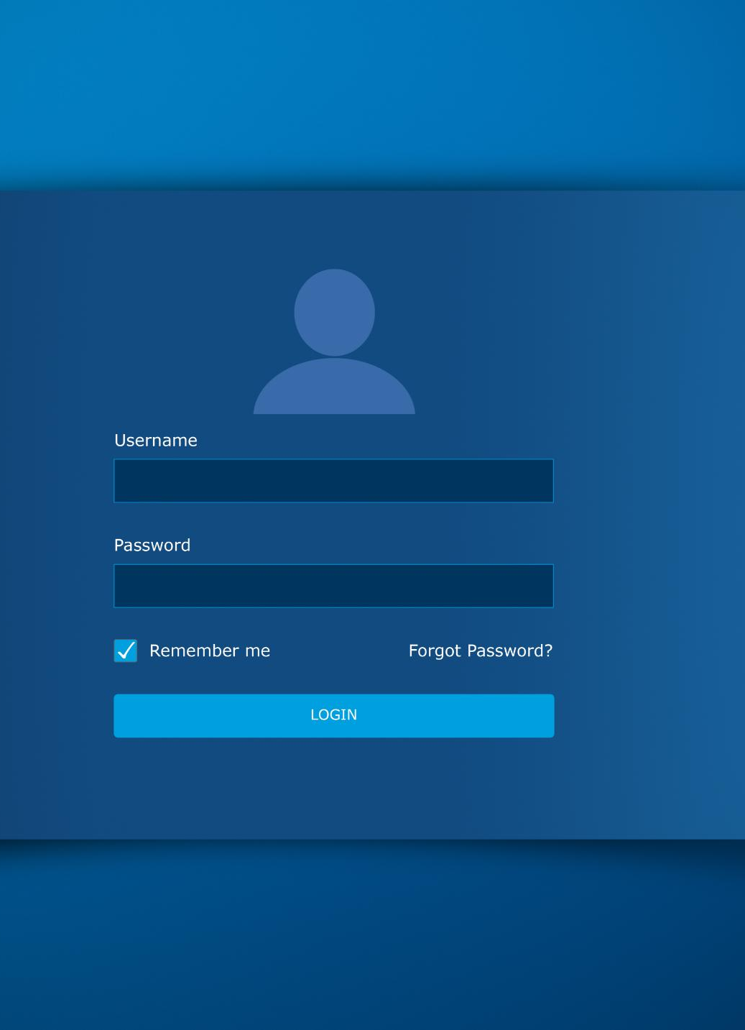
Historical Context and Usage
Longstanding Authentication Method
Username/password authentication has been a reliable method for user login for many years, ensuring ease of access.
Familiarity and Trust
The familiarity of this authentication method fosters user trust, making it a popular choice among applications.
Applications Across Platforms
Username/password authentication is widely adopted across various platforms, from websites to mobile apps, for user authentication.
Notes:
Username/password authentication has been around for decades, offering a straightforward way for users to log in. Its familiarity makes it a go-to method in many applications.

Slide 10

Advantages and Limitations
Ease of Implementation
Username/password combinations are simple to set up and widely used for user authentication across various platforms.
Security Vulnerabilities
These combinations can lead to significant security risks due to weak passwords and the tendency for users to reuse them across services.
Reliability Concerns
The reliability of username/password systems is compromised by user behavior, leading to potential security breaches and unauthorized access.
Notes:
While username/password combinations are easy to implement, they can also lead to security vulnerabilities, including weak passwords and password reuse, making them less reliable.

Slide 11
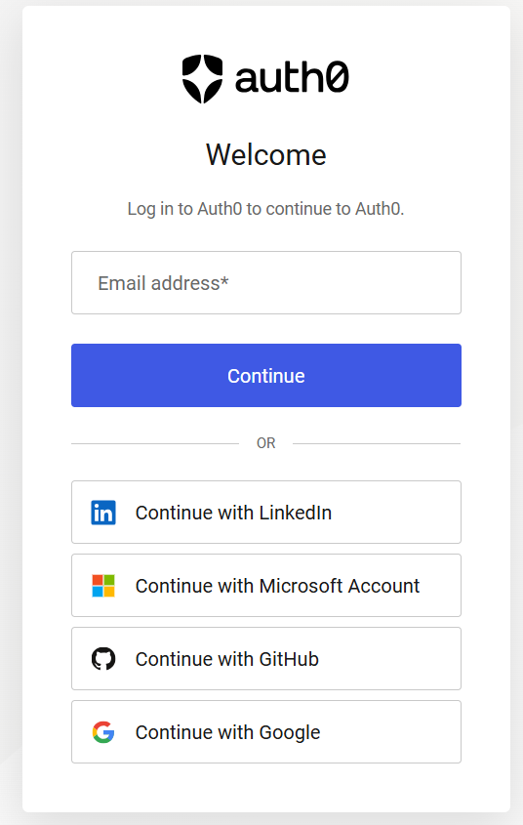
Modern Login Methods
Integration of social media logins is becoming standard.
Username and password forms remain widely used.
Combining both methods enhances user convenience.
Social logins help reduce password fatigue.
Users can choose their preferred login method.
Notes:
Modern applications increasingly incorporate social media logins alongside traditional username and password forms. This dual approach not only enhances user convenience but also reduces instances of password fatigue, allowing users to select their preferred method. By integrating these login options, developers can cater to diverse user preferences and improve overall user experiences.

Slide 12
Moving On Up: Introducing JWT
Notes:
JSON Web Tokens (JWT) offer a modern solution to authentication challenges. They simplify user session management and provide secure, compact tokens that can be easily transmitted.

Slide 13

What Is JWT?
Compact Token Format
JWT is a compact and efficient way to represent information as a JSON object, making it easy to transmit.
Self-Contained Data
Being self-contained, JWT carries all necessary data for authentication and authorization, simplifying secure communications.
Notes:
JWT is a compact token format that encodes information as a JSON object. It is self-contained, meaning it can carry all the necessary data for authentication and authorization.

Slide 14

Comparison with Traditional Methods
Stateless Authentication
JWTs enable stateless authentication, eliminating the need for server-side session storage and management.
Improved Scalability
By using JWTs, applications can scale more effectively as they do not rely on server session states.
Efficiency Over Traditional Methods
JWTs offer a more efficient way for user authentication compared to traditional methods that require session management.
Notes:
Compared to traditional methods, JWTs allow for stateless authentication, meaning users do not need to maintain session states on the server, leading to improved scalability.

Slide 15
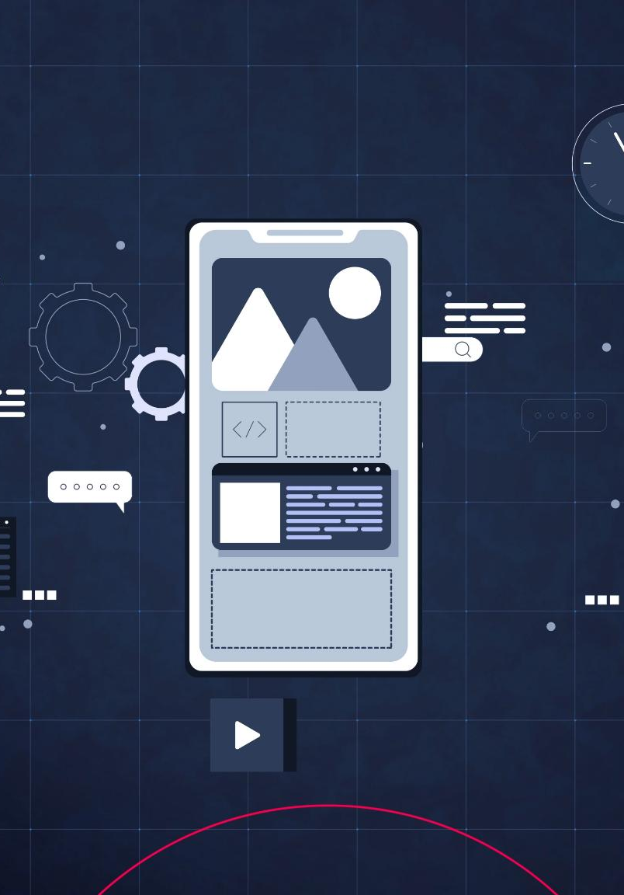
Use Cases and Benefits
Single-Page Applications
JWTs enhance user experience in single-page applications by enabling secure and efficient user sessions.
Mobile Application Security
In mobile apps, JWTs offer improved security while maintaining performance through features like expiration and signing.
User Experience Enhancement
JWTs support seamless user experiences by reducing the need for constant re-authentication, streamlining access.
Notes:
JWTs are ideal for single-page applications and mobile apps, providing a seamless user experience and enhanced security through features like expiration and signing.

Slide 16
How JWT Works Behind the Scenes
Notes:
To understand JWT better, we need to explore its structure and the processes involved in signing and verifying tokens, as well as the role of claims.

Slide 17

Structure of JWT
JWT Components
A JWT consists of three main components: header, payload, and signature, essential for secure information exchange.
Encoding Process
Each part of the JWT is encoded, ensuring the token is compact and self-contained for easy transmission.
Separation by Dots
The parts of a JWT are separated by dots, providing a clear structure for token parsing and validation.
Notes:
A JWT consists of three parts: a header, a payload, and a signature. Each part is encoded and separated by dots, allowing for a compact and self-contained token.

Slide 18
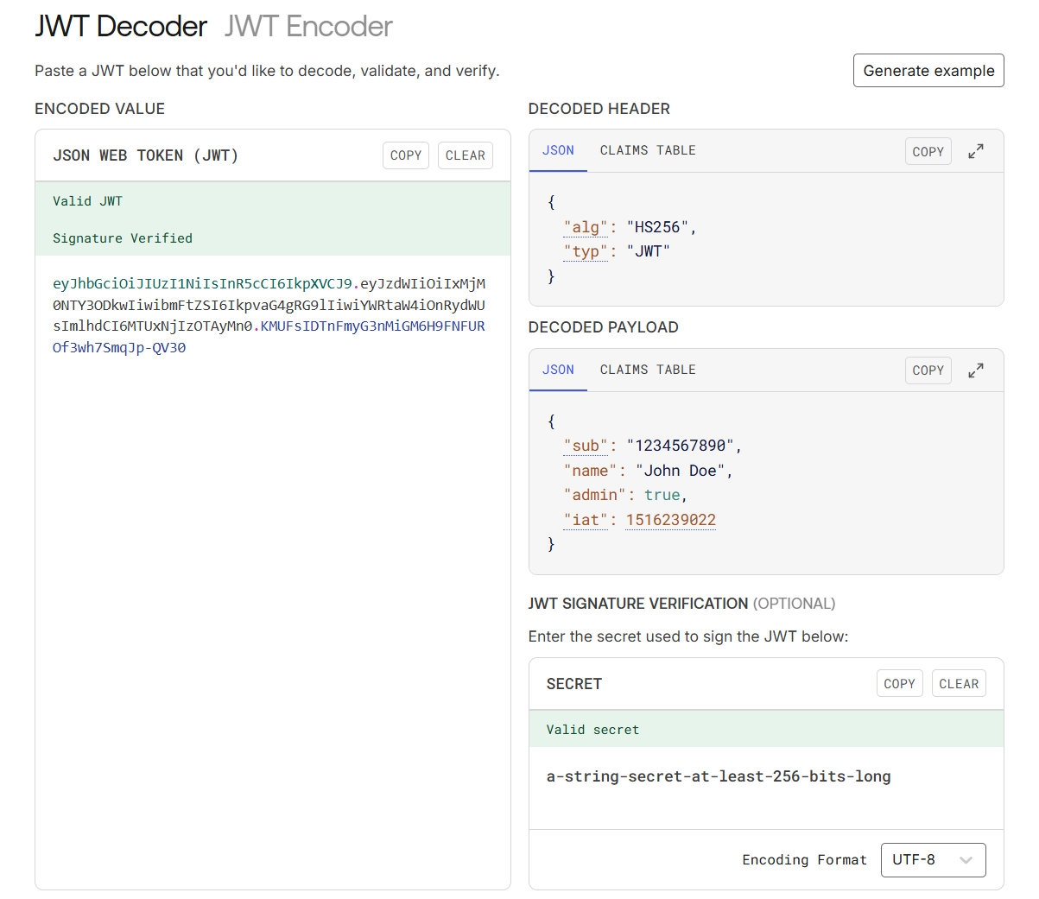
jwt.io

Slide 19
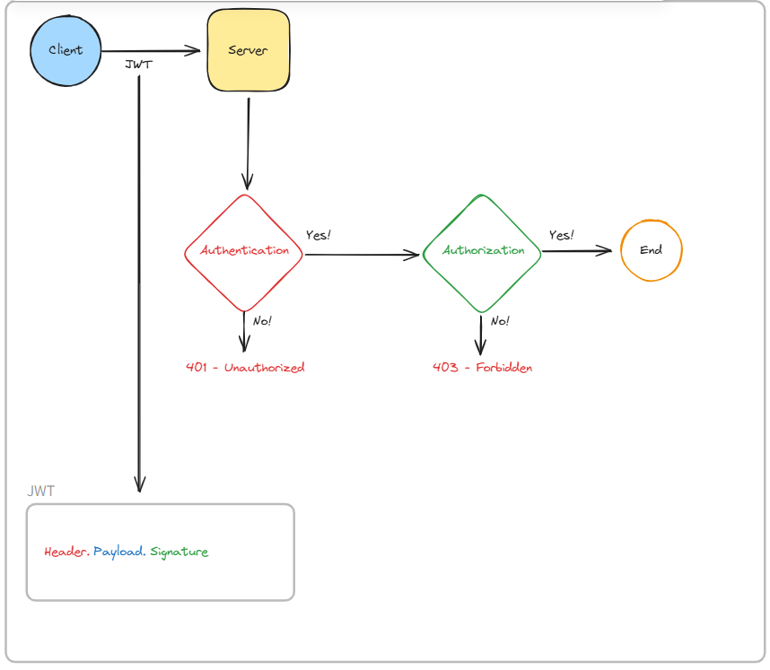
JWT Workflow

Slide 20
What’s the Refresh Token All About Then?
Notes:
Refresh tokens work alongside access tokens to maintain user sessions without requiring repeated logins. They provide a way to obtain new access tokens when the old ones expire.

Slide 21

Purpose of Refresh Tokens
Improved User Experience
Refresh tokens enable seamless user experiences by allowing clients to obtain new access tokens without asking users to log in again.
Token Issuance
Refresh tokens are issued after initial user authentication, providing a secure way to maintain access without re-entering credentials.
Security Benefits
Using refresh tokens enhances security by limiting the lifespan of access tokens, reducing the window of opportunity for attacks.
Notes:
Refresh tokens are issued to clients to request new access tokens without needing to re-authenticate the user, thus improving user experience.

Slide 22
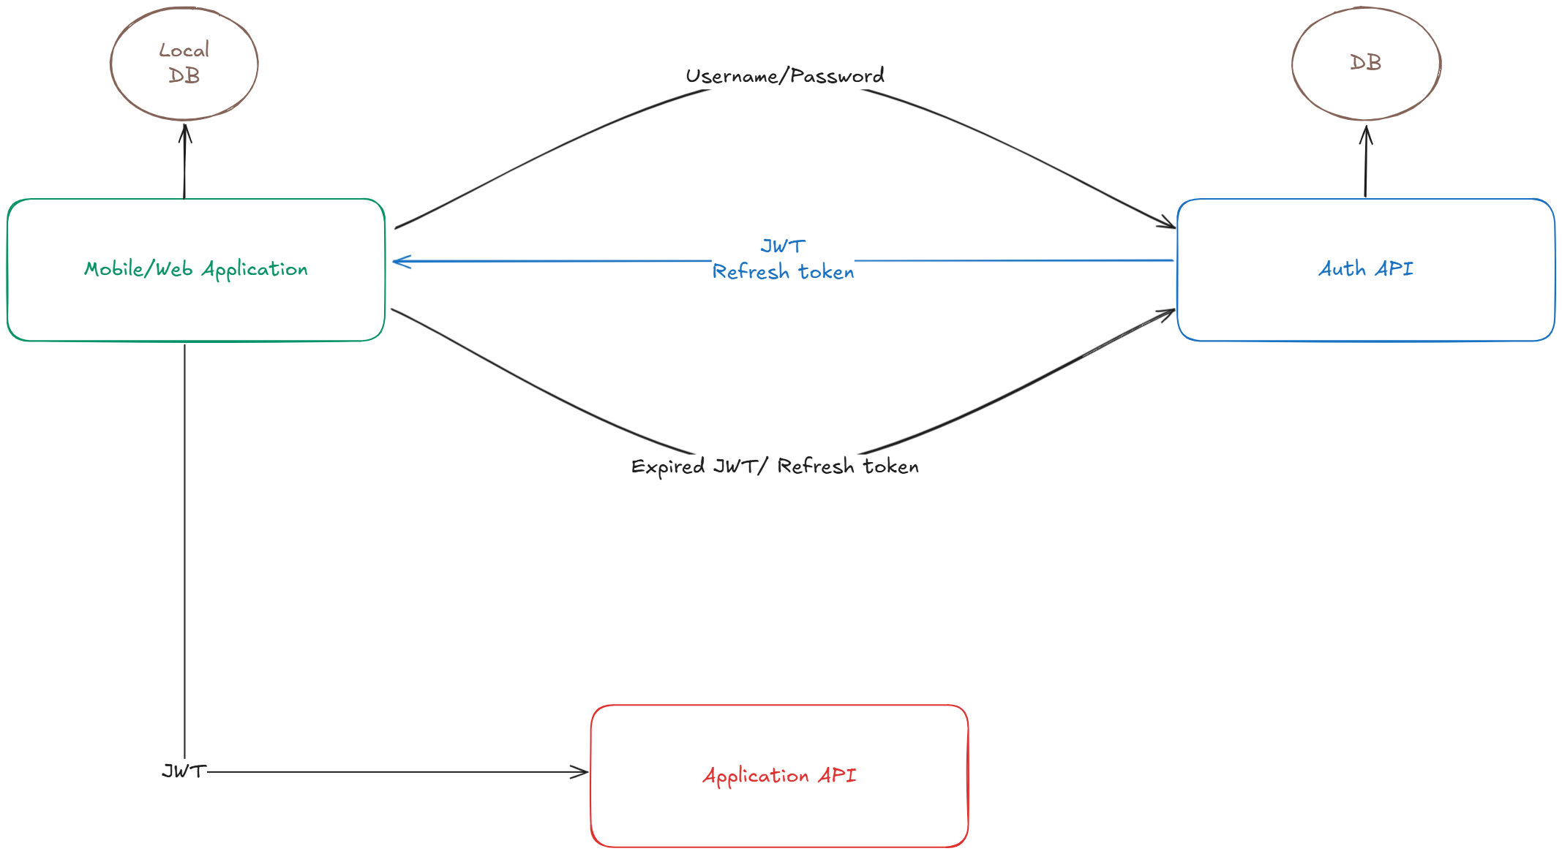

Workflow of Refresh Tokens
Notes:
When an access token expires, the client can send the refresh token to the server to receive a new access token, allowing for uninterrupted access to the application.

Slide 23
ASP.NET Love Story: JWT in Action
Notes:
Let's look at a practical implementation of JWT and refresh tokens within an ASP.NET environment, highlighting best practices and real-world applications.

Slide 24

Implementing JWT in ASP.NET
Authentication Scheme:
The process of determining which handler should manage the authentication.
An authentication handler
Options to configure how to validate token
Middleware Configuration
Configuring middleware in ASP.NET is essential for handling JWT authentication, ensuring secure user sessions.
Notes:
Integrating JWT into an ASP.NET application involves configuring middleware and setting up authentication services to create and manage tokens effectively.

Slide 25
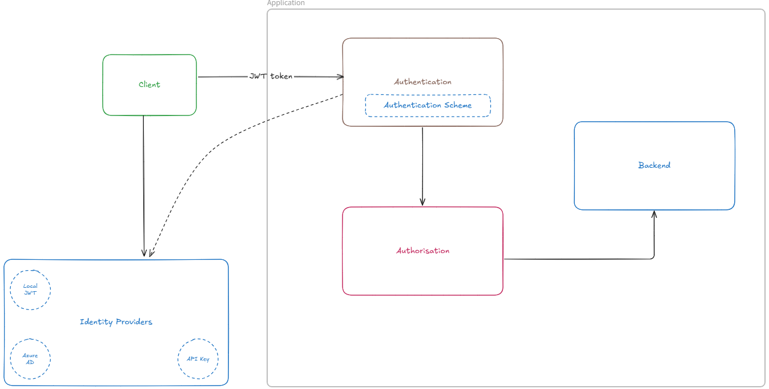
Scenario
Notes:
We will review code snippets that demonstrate best practices for implementing JWT and managing refresh tokens in ASP.NET applications.

Slide 26
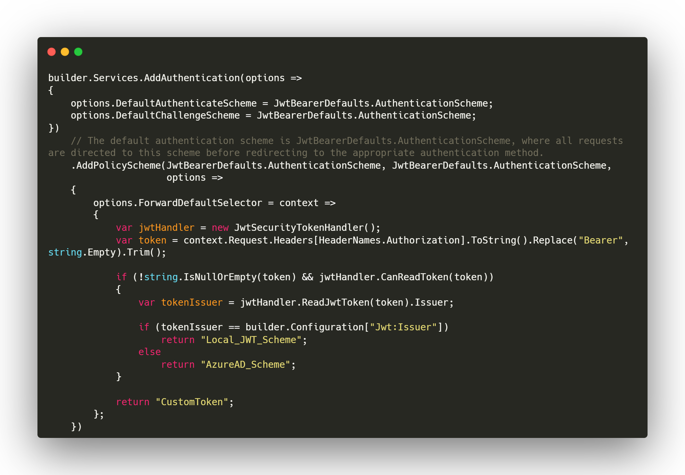
Code Examples
Notes:
We will review code snippets that demonstrate best practices for implementing JWT and managing refresh tokens in ASP.NET applications.

Slide 27
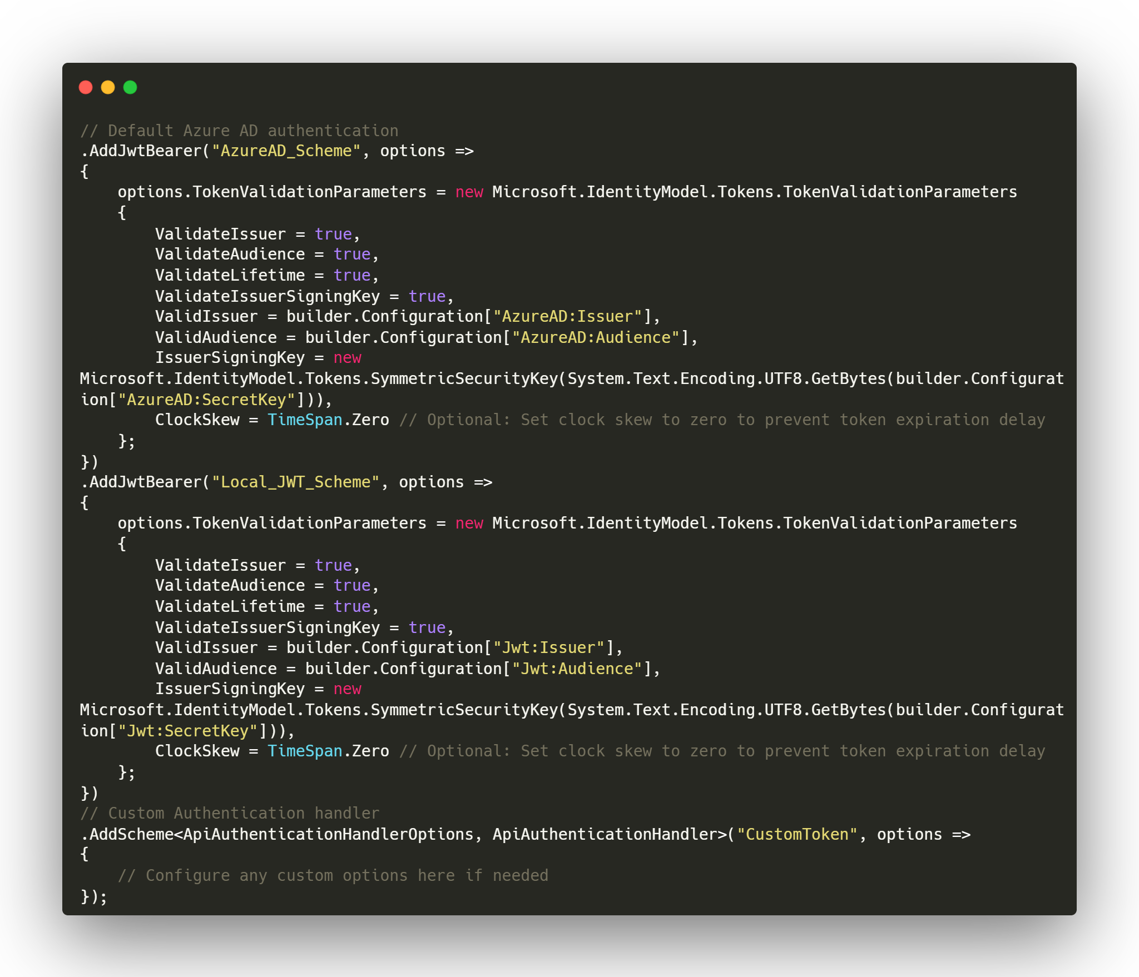
Code Examples
Notes:
We will review code snippets that demonstrate best practices for implementing JWT and managing refresh tokens in ASP.NET applications.

Slide 28
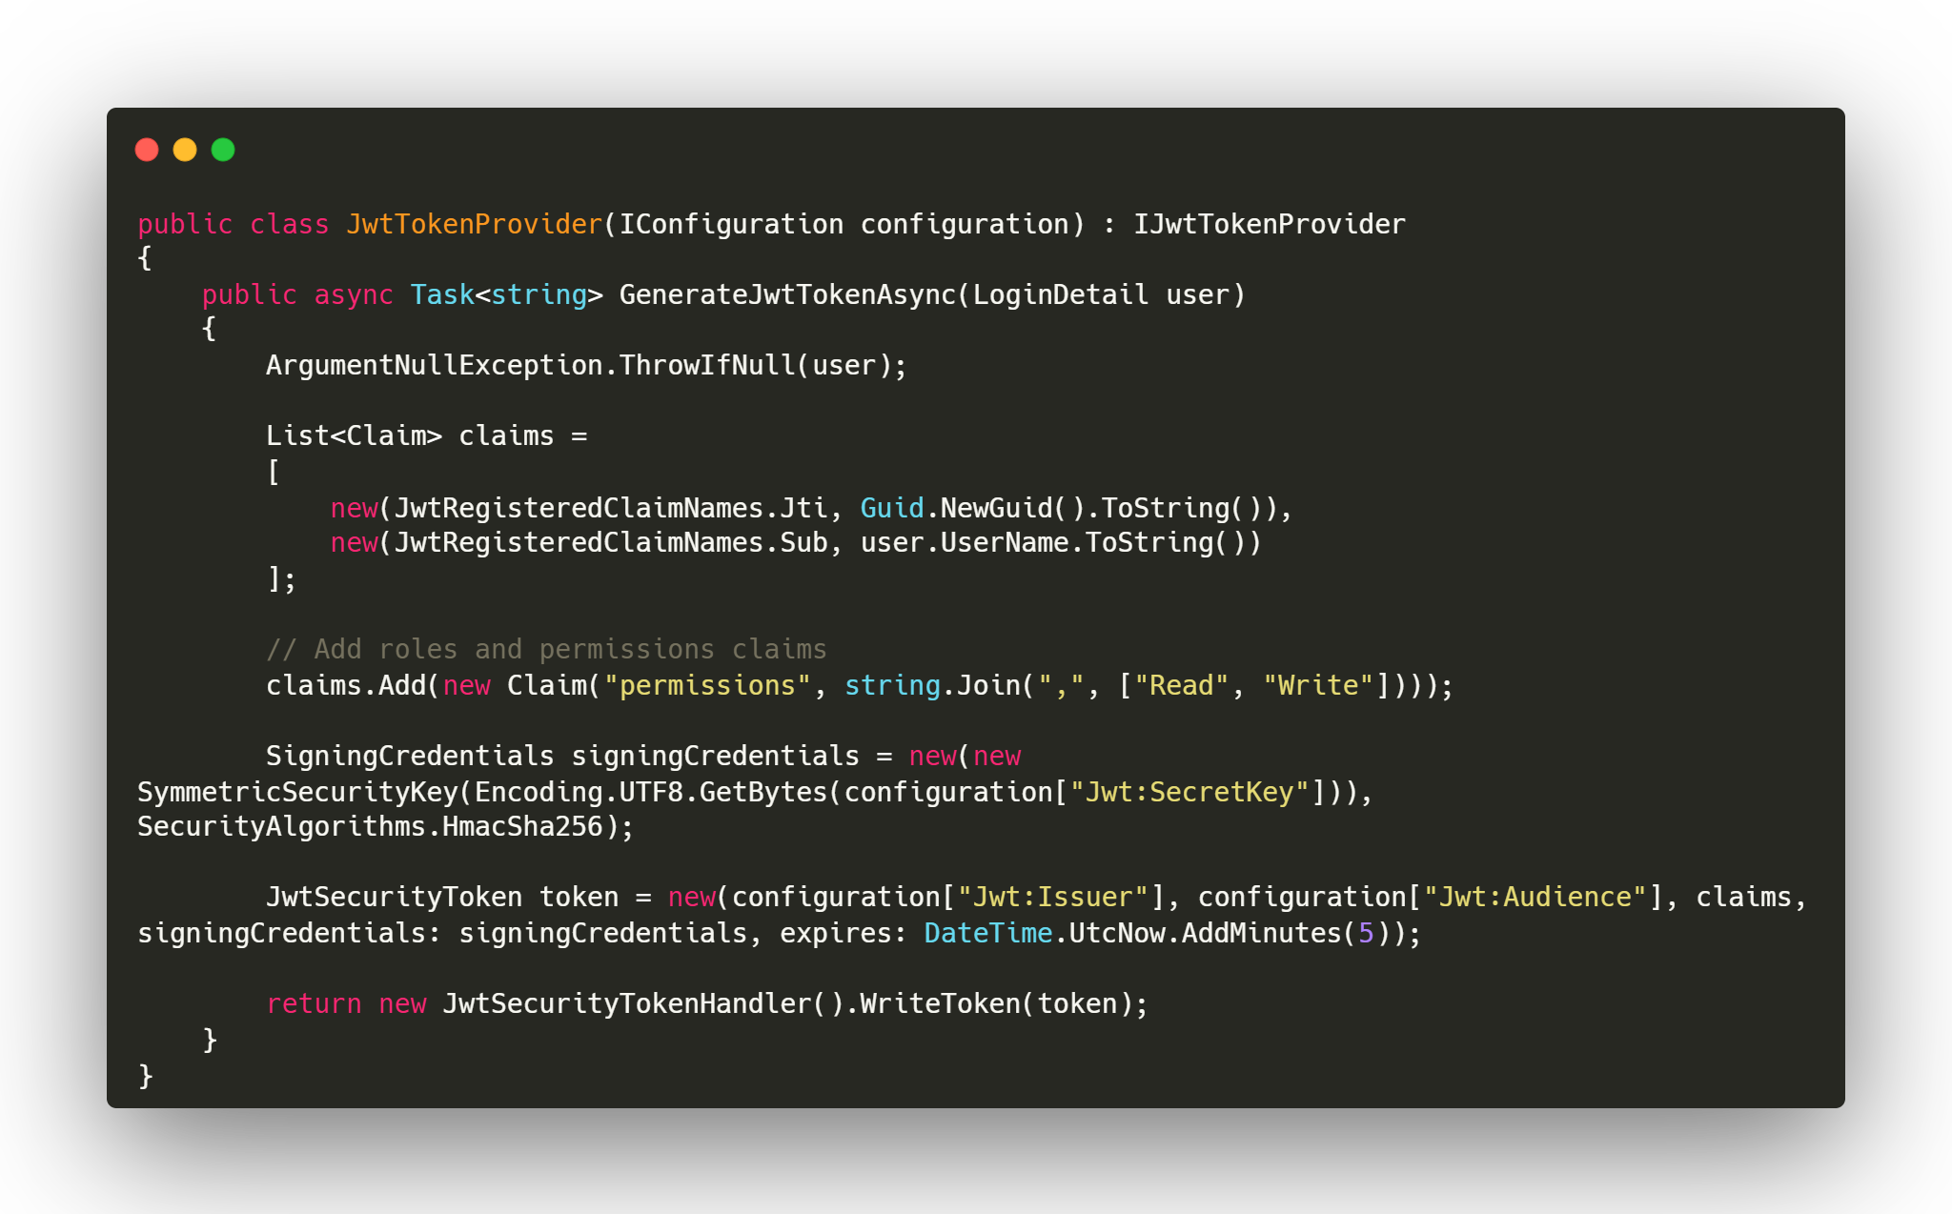
Code Examples
Notes:
We will review code snippets that demonstrate best practices for implementing JWT and managing refresh tokens in ASP.NET applications.

Slide 29
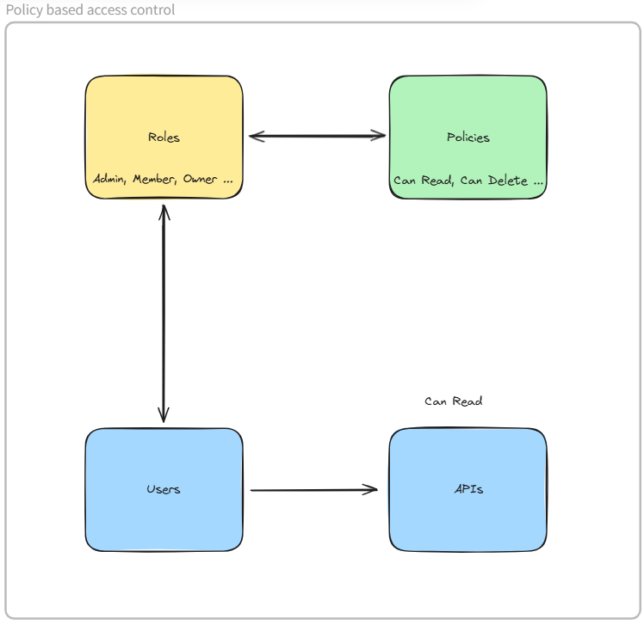
Role vs Policy-based access control
Notes:
We will review code snippets that demonstrate best practices for implementing JWT and managing refresh tokens in ASP.NET applications.

Slide 30
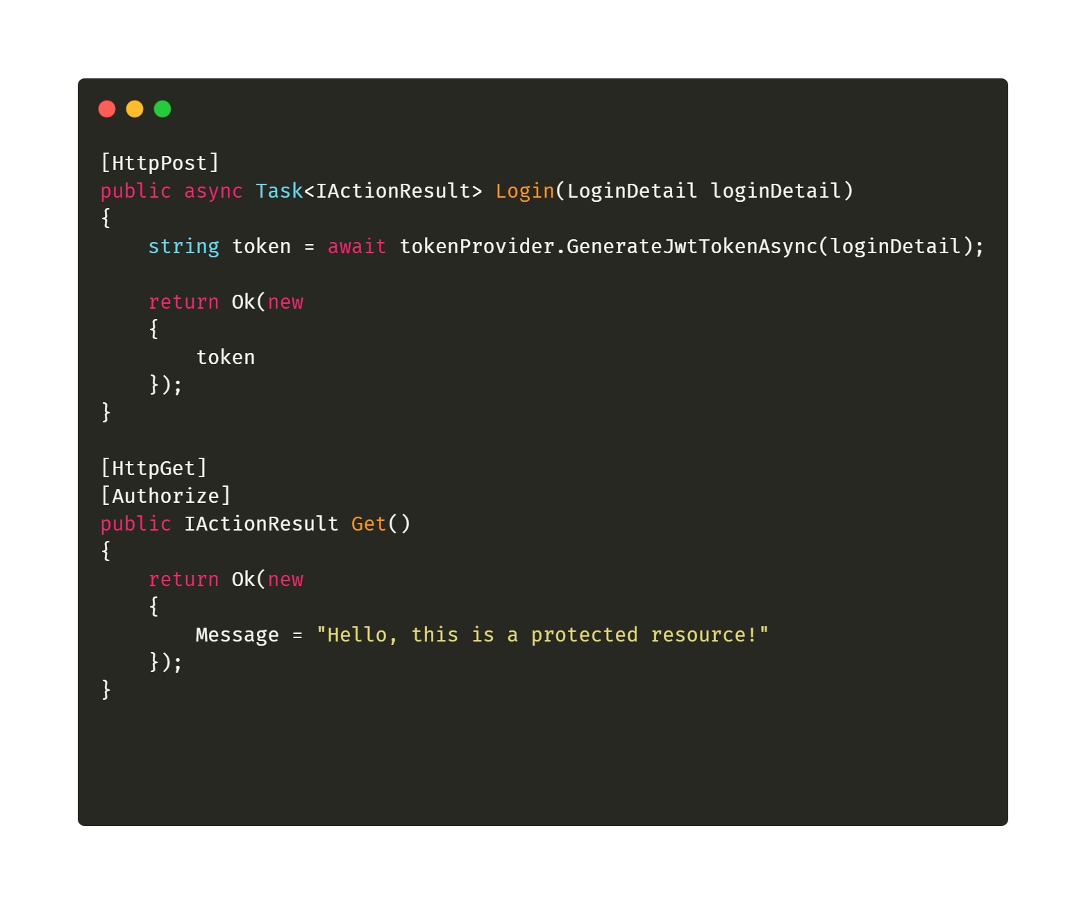
Controller
Notes:
We will review code snippets that demonstrate best practices for implementing JWT and managing refresh tokens in ASP.NET applications.

Slide 31
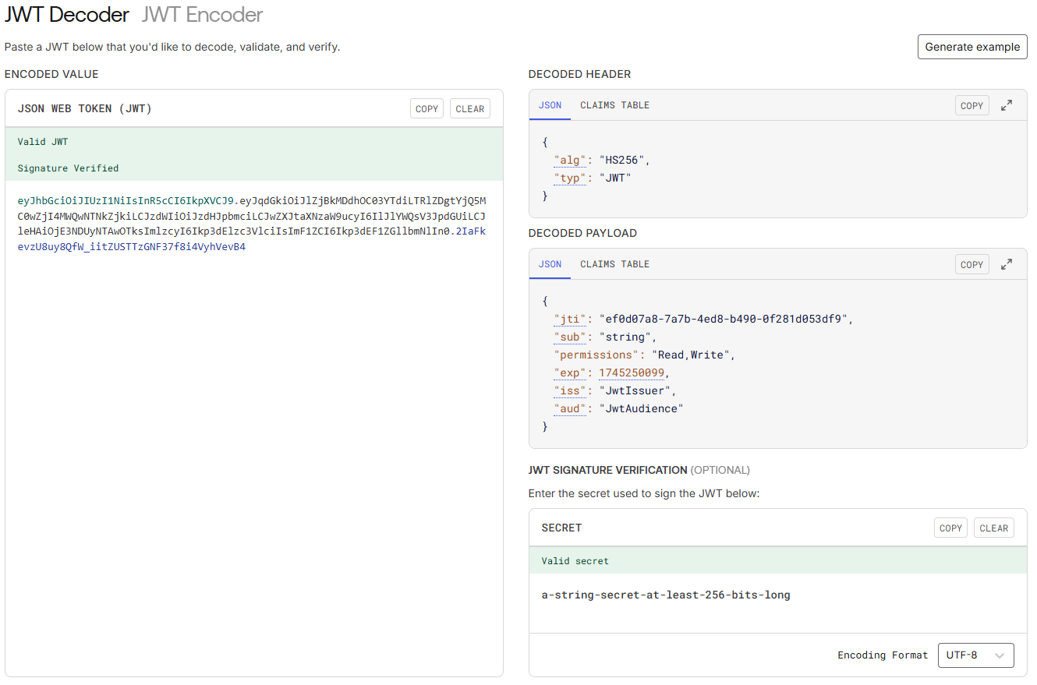
JWT.IO
Notes:
We will review code snippets that demonstrate best practices for implementing JWT and managing refresh tokens in ASP.NET applications.

Slide 32
Picking Your Poison: When to Choose JWT Over Others
Notes:
Choosing the right authentication method depends on various factors, including scalability, security, and user experience. Let's analyze when JWT is the best choice.

Slide 33
Pros and Cons of JWT
Advantages of JWT
JWTs provide statelessness, which enhances scalability and allows for efficient data transfer without server-side sessions.
Challenges of Token Management
Managing JWT tokens can be challenging due to issues related to expiration, revocation, and storage, requiring careful implementation.
Security Risks
Improper implementation of JWTs can lead to security risks, including token theft and misuse, highlighting the need for secure practices.
Notes:
JWTs offer several advantages, such as statelessness and scalability, but also come with challenges like token management and potential security risks if not implemented correctly.

Slide 34


Final Thoughts on JWTs
Powerful Authentication Tool
JWTs provide a robust method for implementing authentication in modern applications, increasing overall security.
Enhancing Application Security
By using JWTs, developers can effectively protect user information and reduce the risk of unauthorized access.
Improving User Experience
JWTs simplify the authentication process, allowing users to enjoy seamless access to applications with minimal friction.
Notes:
In summary, JWTs are a powerful tool for modern authentication. By adopting JWTs, developers can enhance application security and improve user experiences with seamless authentication flows.

